Slide 1
ECE Graduate orientation
August 14, 2019

Slide 2
Agenda
WEDNESDAY, AUGUST 14, 2019 – 113 Dreese Labs
General Information on ECE Graduate Program (8:30 AM -10:40 AM)
Meeting with Faculty to select Fall 2019 courses
11:15-12:00 PhD students meet in Dreese Lab 259, 260, 267 by research area
11:30-2:00 MS students meet with advisors in - Dreese Lab. 305 (Prof. Irem Eryilmaz), - Dreese Lab. 357 (Prof. Lisa Fiorentini) - Dreese Lab. 369 (Prof. Wladimiro Villarroel)
FRIDAY, AUGUST 16, 2019 – 113 Dreese Labs
Breakfast and Introduction (8:30 AM – 9:00 AM)
Wellness and Academic Success (9:00 AM – 10:30 AM)
Campus Tour (10:30 AM – 11:00 AM)
Poster Competition (11:00 AM – 12:00 PM)

Slide 3
ECE Department

Slide 4
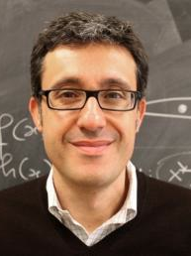
ECE Department
Prof. Hesham El Gamal
Department Chair
Oversees the Department (policies, finance, hiring,…)
Prof. Andrea Serrani
Associate Chair for Faculty Affairs
Past Graduate Studies Chair
Prof. Betty Lise Anderson
Associate Chair
Prof. Atilla Eryilmaz
Graduate Studies Chair
Oversees the Graduate Studies Committee
Notes:
Consistency and integrity

Slide 5
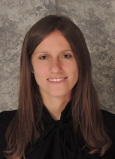
ECE Department
If you have questions about research and courses:
Course selection and course plan development;
Research guidance;
Your thesis (MS or Ph.D. students);
Your non-thesis project and report (MS students).
Ph.D. students: contact your advisor (need to find an advisor by the end of your first year)
MS students: contact your advisor (if you already have been assigned an advisor) or:
Irem Eryilmaz
Communication
Signal Processing
Networking
Learning
Lisa Fiorentini
Control Systems
Robotics & Intelligent Transp.
Computer and Digital Systems
Computer Vision & Image Processing
Sustainable Energy & Power
Wladimiro Villarroel
Electromagnetics
Remote Sensing and Microwaves
Analog and RF Circuits
Electro-optics & Photonics
Nanotechnology & Electronic Materials

Slide 6
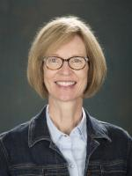
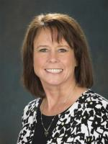
ECE Department
If you have questions about all things administrative:
Program policies;
Degree requirements;
University and Grad School issues ( graduation, deadlines, missing grades,..)
Ph.D. students contact:
Patricia Toothman
PhD Program Coordinator
Walk-in hours: Mon-Thurs 2-4pm
MS students contact:
Beth Bucher
MS Program Coordinator
Walk-in hours: Mon-Thurs 2-4pm

Slide 7
Welcome NOTES
Welcome to the Grads @ ECE family!
This is the best time of your lives, when you get to develop yourself, make lifelong friends, and grow to become happy and productive members of the broader society.
Our goal is to create an environment that will allow you to grow to become increasingly more capable, responsible, hard working, and confident individuals.
You are both the fuel and the product of this department.
Each of you arrive here with a unique background and a unique trajectory.
Take the initiative to make the best of what is available to you.
Notes:
Lifelong relationship.

Slide 8
Some Advice
You are ultimately the ones who will determine how you will proceed in this experience.
Your attitude and habits will greatly shape your experience.
Be aware of your responsibilities early on, and proactively work on them.
Try to start well: set S.M.A.R.T. goals, control your schedule.
Set and maintain a healthy lifestyle: Exercise, Eat, and Sleep well.
Move out of the “Grade-Oriented” Undergraduate Mindset towards the “Growth-Oriented” Graduate Mindset
Try to be well-connected, friendly, and considerate.
Speak English in public spaces so that you are inclusive of others.
Stay positive. Work hard while also enjoying the adventure.
Form and maintain a good communication with your advisor. Use resources to find your path, but do not hesitate to ask questions if you are lost.

Slide 9
Social network connectivity
We have created a closed facebook group for all incoming 2019 Fall graduate students
It will maintain connectivity and share useful information (including these slides)
Please become members of the facebook group by August 23rd :
In-Class 2019 ECE Grads @ OSU
The link to this group is:
https://www.facebook.com/groups/694374024320485/
Open this link and click “Join Goup” button to send request
This link will also be available online at:

Slide 10
Plan of Study
Graduate Student Survival Skills Workshop
Time: Sunday, August 25, 2019 1:00 PM - 4:30 PM
Location: Ohio Union
The goal of this event is to aid in your transition to graduate school and will address:
Challenges faced in graduate school, the surprises you may face, and general advice for this stage in your career
Panels of current graduate students will provide firsthand accounts of important things such as time management strategies, the role of self-advocacy, developing a relationship with your advisor, how to successfully navigate the transition from undergraduate to graduate student, etc.
Panels will be discipline specific in addition to a panel for students who are parents
You will also learn about resources and services available to support your academic success throughout graduate school
Designed specifically for new graduate and professional students
The workshop is free to attend and food and beverages will be provided.
To register for the workshop click register or go to visit go.osu.edu/gsss

Slide 11
OSU Operations
GRADUATE SCHOOL (http://www.gradsch.osu.edu)
Forms;
Register for courses that require permission to enter;
Ask questions about what courses count towards your degree; (they will do the audit when you graduate)
ECE GRADUATE STUDENT HANDBOOK (https://ece.osu.edu/current-students/graduate-student-handbook)
STUDENT SERVICE CENTER (http://ssc.osu.edu/index.html)
Questions regarding tuitions and fees;
Questions regarding when you can register/add/drop courses;
Office: 281 W. Lane Ave, Student Academic Services Bldg., Lobby - Email: ssc@osu.edu
REGISTRAR (handles course registration)
BURSAR (handles tuitions and fees)
OFFICE OF INTERNATIONAL AFFAIRS (http://oia.osu.edu)
Questions regarding your VISA. For international students keeping the student VISA status is the most important thing. Consult with OIA if you want to learn about CPT and OPT opportunities.

Slide 12
Graduate degrees

Slide 13
Graduate Degrees
PhD Program
The PhD Program offers a unique opportunity for an individual to conduct intensive and prolonged research on a particular topic, leading to archival publication. In the first 1-2 years students take courses to fulfill degree requirements and broaden their knowledge. In the next 2-4 years, students focus on their research and final dissertation.
MS Program
The MS Program aims to give you the opportunity to develop your expertise in a specialized field. In the first two semesters students take courses to fulfill degree requirements. In the next 1-2 semesters, students focus on their project/thesis.
Note: The course workload is typically heavier than in college, the courses are more demanding and much more is expected from the students, both at the PhD and the MS level.
Students can choose one of two options depending on educational and professional goals
Students collaborate with industry partners in projects, perform a research project, do an internship project or work in a relevant project
Concludes with a Project Report and technical discussion and or presentation
Different
paths
Same diploma
Project
path
(non-thesis)
Research
path
(thesis)
Students work on industrial or academic research
Concludes with a Thesis and final oral defense

Slide 14
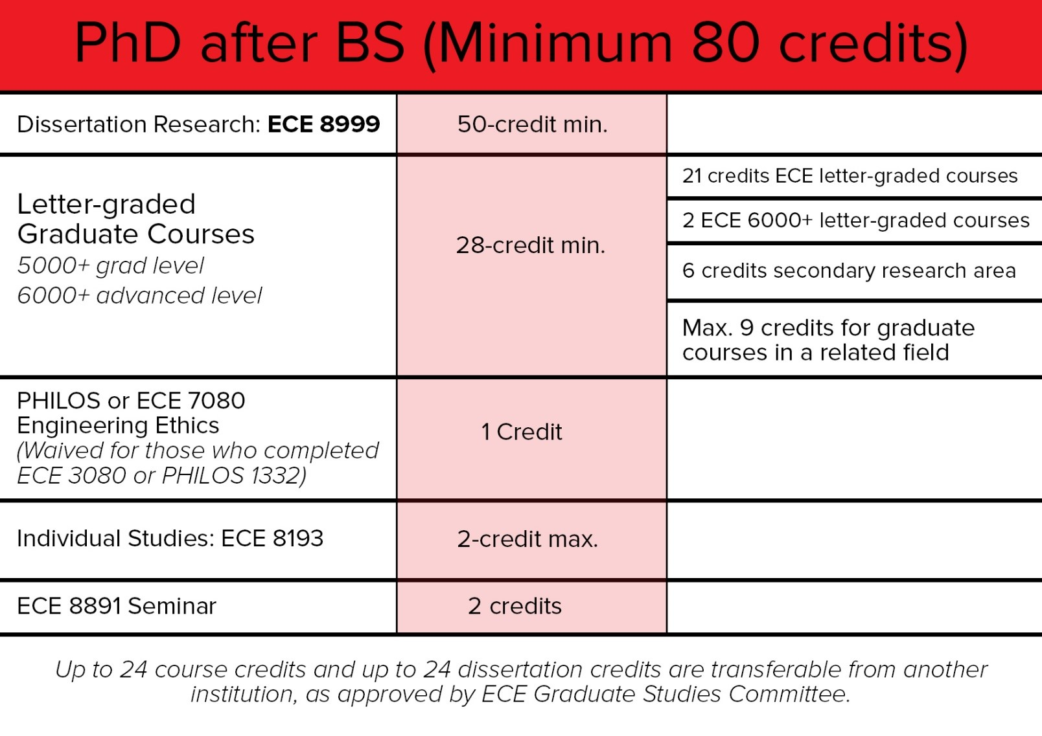
PhD after BS Requirements
Notes:
Be careful of the requirements, especially
Needs to be updated by Tricia: two 6XXX courses for MS/Phd; Plan of study by the end of 1st semester;
for PhD by Qualifier, 2+ courses in primarily area, and 1+ course in primary area; one of these may be in the 3rd semester itself
Limitation on the number of research credits in the early phase ?

Slide 15
PhD after MS Requirements

Slide 16
MS non-thesis Requirements

Slide 17
MS thesis Requirements

Slide 18
Curriculum Areas
CURRICULUM AREAS
Analog and RF Electronic Circuit
Bioengineering
Communication and Signal Processing
Computer and Digital Systems
Networking
Computer Vision and Image Processing
Control Systems
Robotics and Intelligent Transportation
Electromagnetics, Remote Sensing and Microwaves
Electro-optics and Photonics
Nanotechnology and Electronic Materials
Sustainable Energy and Power Systems

Slide 19
Plan of Study
PLAN OF STUDY
MS Students need to have their plan of study approved by their advisor by the end of their first semester;
Effective Autumn 2019: PhD students need to submit their plan of study by the end of their first semester;

Slide 20
PhD Exams
PhD Qualifying Exam (QE)
Allows a student to earn the status of doctoral student by
Testing the fundamental knowledge acquired by the student over prior coursework
Assessing the student’s ability to apply this knowledge towards research problems
PhD students are required to take the QE in the first semester of their second year
Failing two attempts leads to dismissal from the PhD program (MS degree can still be earned after completing MS requirements)
Failure to take the QE during the required semester counts as a failed attempt.
Effective Autumn 2019: Students starting the ECE PhD program in autumn 2019 and after must complete two graduate letter-graded ECE courses in their primary research area and one graduate letter-graded ECE course in their secondary research area by the term the QE is scheduled. One of the three required courses may be taken during the semester when the QE is administered. 5000-level courses will meet the ECE QE course requirement.
Failure to do so will be considered a failed attempt.

Slide 21
PhD Exams
PhD Candidacy Exam (CE)
Establishes the suitability of the PhD student’s research proposal to constitute a viable dissertation topic. Elevates the student’s status to PhD candidate.
The CE is usually administered one year prior to the student’s expected graduation
Failing two attempts results in dismissal from the PhD program.

Slide 22
Graduate Education
You are here to learn and to make a contribution to engineering science
You have the unique opportunity to earn a life-long body of knowledge. Take advantage of it.
Do not be reluctant to take high-level courses just because they are difficult
Invest in gaining expertise in fundamental disciplines (math, physics…)
Be involved: Attend seminars and colloquia, especially outside your own specific research topic

Slide 23
Graduate Appointments
GRADUATE APPOINTMENTS
OSU fellowships are for PhD students only;
Most GRA, GTA appointments are for PhD students
GTA and GAA appointments:
Prof. Betty Lise Anderson
GRA appointments:
Individual faculty members, or laboratories
GRA/GTA/GAA appointments in other departments,
e.g. Math TA positions, see the Math department.

Slide 24
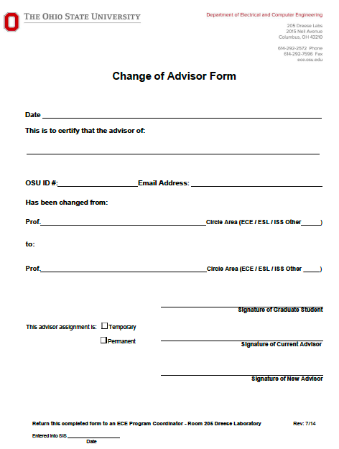
Advising
PhD students who are NOT GRAs:
A professor must agree to be the student’s permanent advisor by signing a change of advisor form by the 2nd semester.
MS students:
Advisors are Profs. Irem Eryilmaz, Lisa Fiorentini or Wladimiro Villarroel, unless another Faculty has already agreed to be the student’s advisor
Change of Advisor
To change advisor, one must fill out a change of advisor form and have both the new and current advisor sign it.

Slide 25
Academic Misconduct
The university's Code of Student Conduct defines academic misconduct as
“Any activity that tends to compromise the academic integrity of the University, or subvert the educational process.”
Academic Misconduct include, but are not limited to, the following:
Any situation in which a student presents work as being their own but it is not:
copying or cheating during an exam;
lifting material uncited from the internet (even if not copyrighted);
using others’ homework, lab reports or projects as a basis of your own.
Falsification or dishonesty in conducting or reporting lab/research results;
Serving as or asking another student to serve as a substitute for taking an exam;
Alteration of grades in an effort to change earned credit or a grade;
Violation of course or program rules.
INSTRUCTORS ARE REQUIRED TO REPORT ACADEMIC MISCONDUCT
Consequences can be very severe (ranging from getting no credit on an assignment to being expelled from the University)
For more info on Academic Misconduct, please visit http://oaa.osu.edu/coam.html

